Slide 2
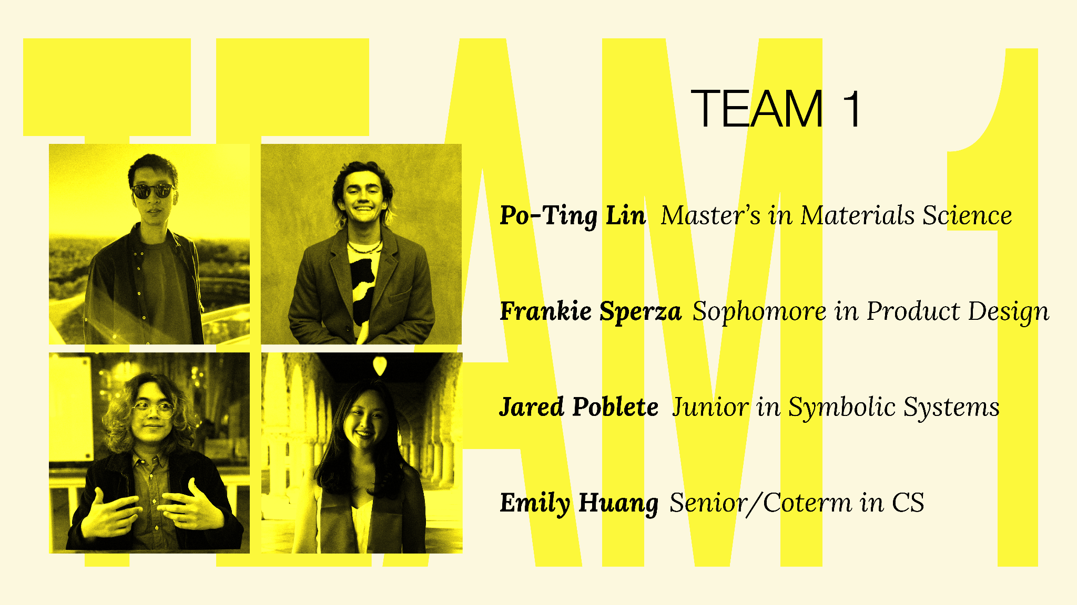

Slide 4
INITIAL POV
Johnny, a hard of hearing college graduate who studied biology and grew up in a hearing household
We met…
We were surprised to notice…
He prioritizes listening to and understanding the lyrics in a song
We wonder
if this means…
Lyrics and words are an integral part of experiencing music as a member of the Deaf / HoH community
It would be game- changing to…
A consistent way to understand and experience the lyrics to a song

Slide 5
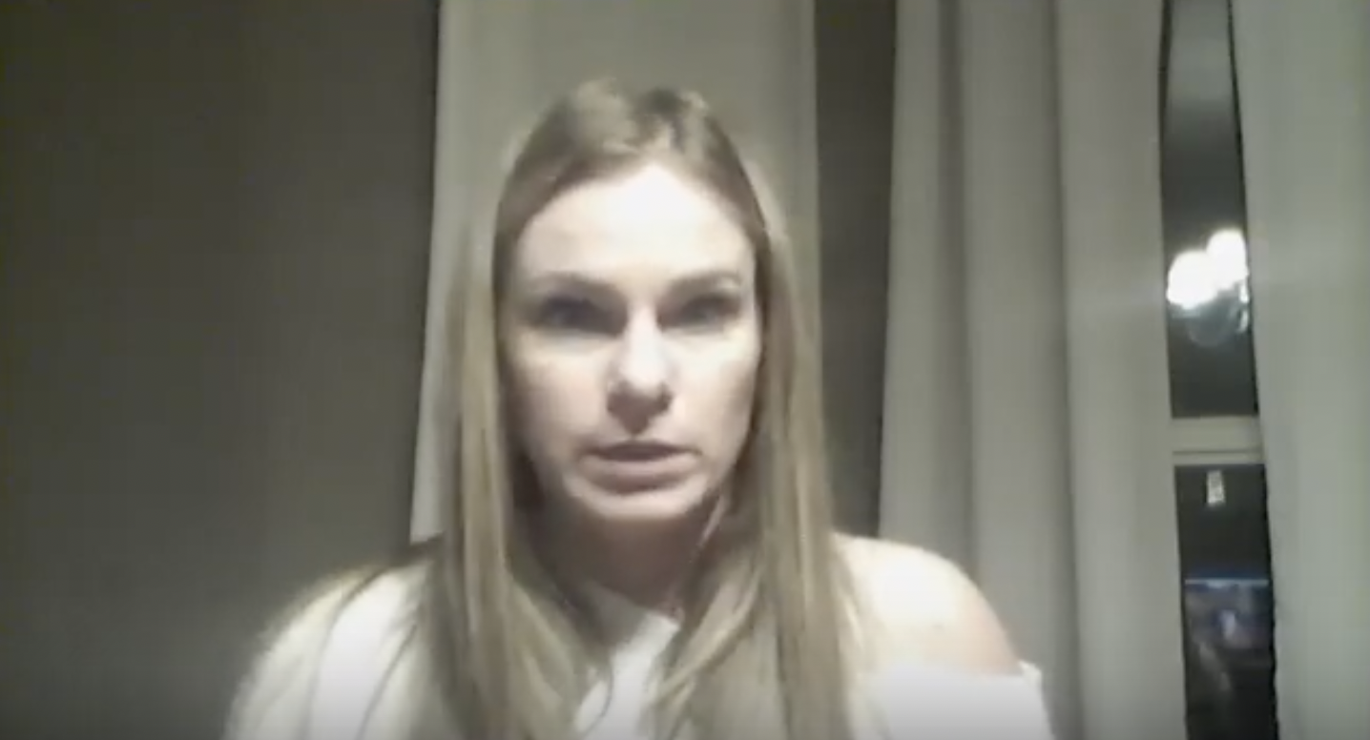
ADDITIONAL NEEDFINDING
Quotes
“He hums and tries to sing along to music.”
“He will watch [Youtube videos] with or without his technology [cochlear implants]”
DEE & MASON
“He gravitates toward ASL, and outside of this household our family doesn’t know enough”
Hearing mom of Deaf child

Slide 6
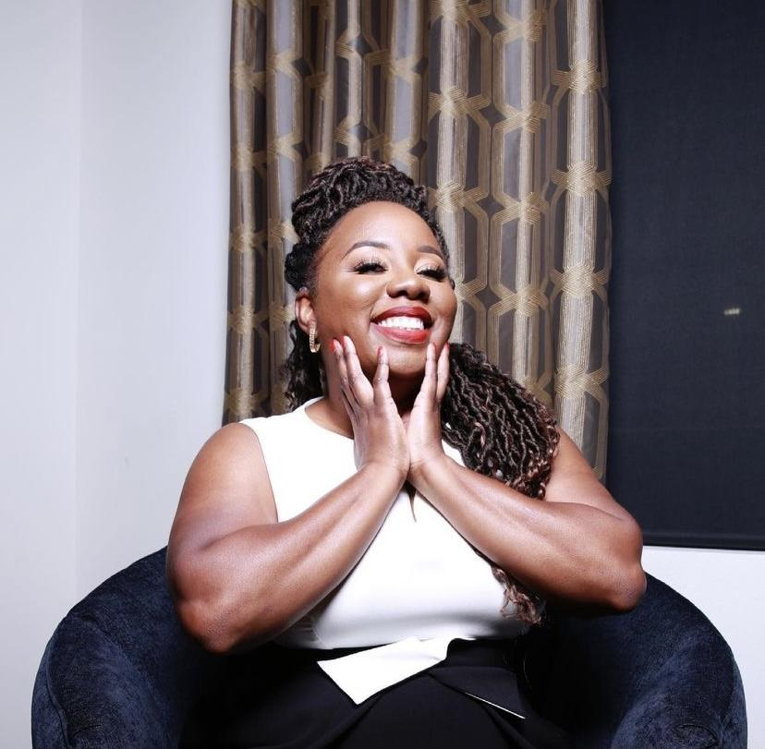
ADDITIONAL NEEDFINDING
Quotes
“My hair texture would not allow the magnet to stick to the side of my head.”
“I think that inclusiveness is first thought about as race and gender, and disability last.”
JESSICA DAVIS
“I’m just trying to figure out what I can do and what I can’t without [the cochlear implant]”
Cochlear Implant Wearer and Board Member of MindWorks Collaborative

Slide 7
REVISED POV 1
CJ, a Deaf mother and ASL professor who grew up in a predominantly deaf household
We met…
We were surprised to notice…
CJ was saddened that some deaf children aren’t exposed to sign language in their homes
We wonder
if this means…
A more important part of ASL education occurs at home and due to a community of ASL users
It would be game- changing to…
Connect disperse members of the deaf / HoH community to feel less isolated

Slide 8
REVISED POV 1
How might we?
integrate the cultural significance of ASL into education
support education for deaf children/hearing parents on ASL and/or the Deaf community
make learning ASL more collaborative
create an immersive experience for people trying to learn ASL
make families with deaf children aware of the importance of sign language
connect more people in the community by using sign language
support connection between various hearing ability communities
make language learning approachable instead of intimidating
make ASL commonly taught in schools
make Deaf events more widely known (especially for deaf children)
assist predominantly hearing schools to support deaf children
make learning ASL easy from everywhere

Slide 9
REVISED POV 2
Johnny, a hard of hearing college graduate who studied biology and grew up in a hearing household
We met…
We were surprised to notice…
He prioritizes listening to and understanding the lyrics in a song
We wonder
if this means…
Lyrics are a way for Deaf/HoH people to participate in the pop culture phenomena of music
Integrate lyrics into the experience of music in a way that is engaging; find ways to make Deaf/HoH people feel included in pop culture
It would be game- changing to…

Slide 10
REVISED POV 2
How might we?
keep listening fatigue in mind when adapting predominantly listening technologies
incentivise the adoption more accessible practices for the deaf / HoH community
find a better medium for DHH people to engage in pop culture
highlight musical intricacies without the proper auditory technology
emulate the energy of a live show or entertainment setting
make reading lyrics / words as exciting as listening to music
encourage smaller venues to support lesser represented people (HoH / Deaf community)
emulate the energy of a more intimate setting
better describe music – (i.e. feelings, emotions, instruments)
support the visual experience of exploring alternate media
make podcasts better to listen to for deaf people
improve captioning for live music

Slide 11
REVISED POV 3
Johnny, a hard of hearing college graduate who studied biology and grew up in a hearing household
We met…
We were surprised to notice…
He skips YouTube videos that do not have captions
We wonder
if this means…
He feels left out when videos that he thinks might be engaging do not have captions
It would be game- changing to…
Invite him into spaces of interest by ensuring clarity and understanding

Slide 12
REVISED POV 3
How might we?
assist creators in ensuring their content supports the Deaf and HoH communities
place the onus on the hearing person to make their content more accessible
make hearing people aware that their content is not accessible to Deaf / HoH people
educate others about the Deaf community and accommodations needed
how can we convey nuanced descriptions in a non-auditory way
grade every online video on the quality and accuracy of its caption
make closed captioning more reliable and consistent
make understanding more collaborative between Deaf / HoH folks
encourage others to better consider accessibility concerns
improve the way that closed captions are delivered
make CC more engaging
find an alternative to captioning

Slide 13
HMW: POV 1
How might we enable connection between the Deaf and Hard of Hearing community and individuals outside of it?

Slide 14
HMW: POV 2
How might we prioritize feeling connected through shared experiences for Deaf / HoH people?

Slide 15
HMW: POV 3
How might we convey nuanced descriptions in a non-auditory way to include the Deaf / HoH community in pop culture?

Slide 16
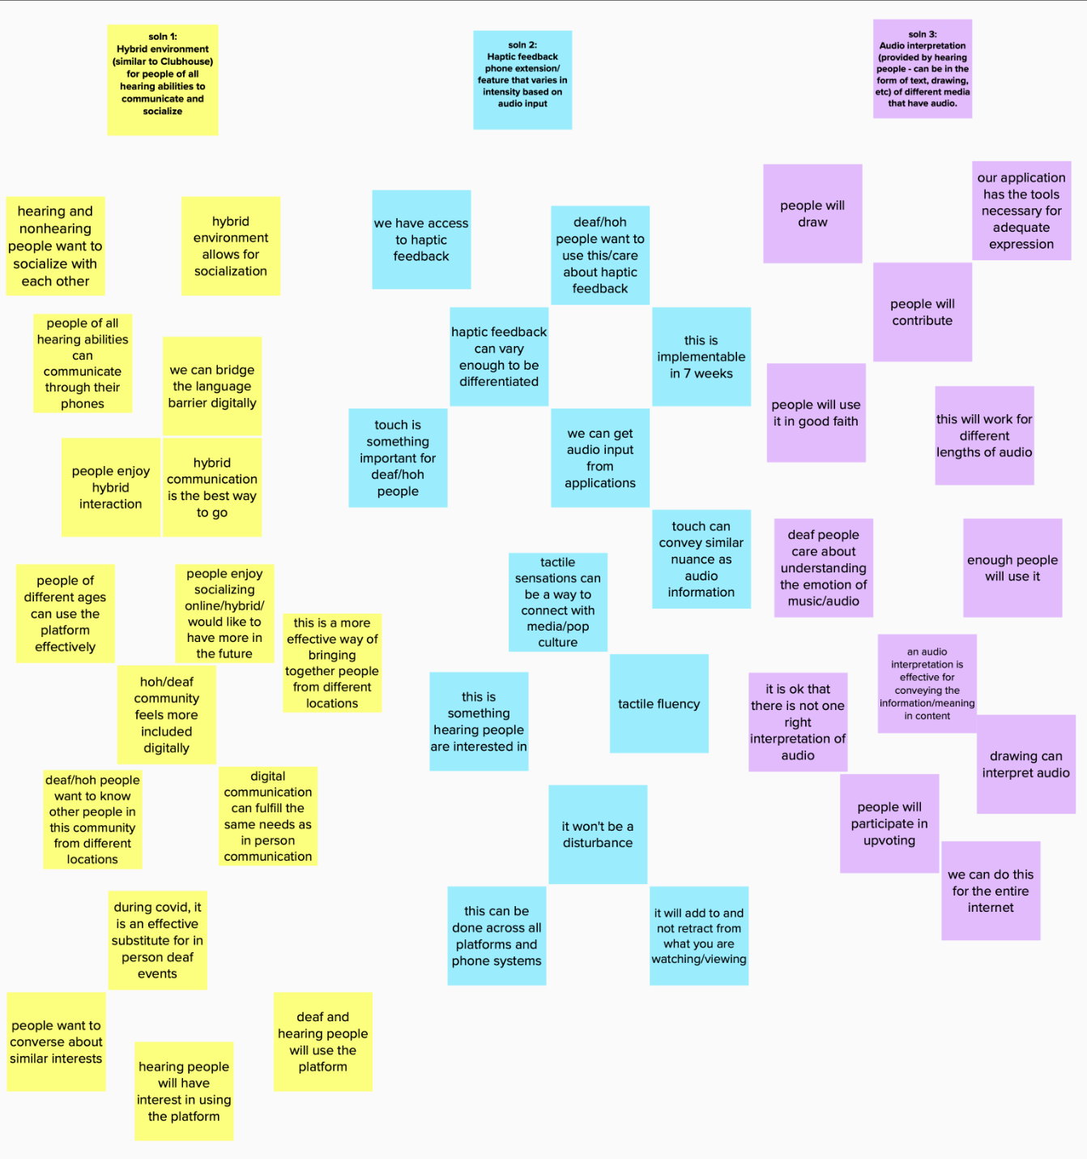
SOLUTIONS

Slide 17
SOLUTION
Virtual group environment (similar to Clubhouse) centering people in the Deaf / HoH community that supports their preferred method of communication.
Some rooms specifically for ASL (no audio), some with combination of video+audio+text (in form of captions)

Slide 18
SOLUTION
Haptic feedback phone extension/ feature that varies in intensity based on audio input.

Slide 19
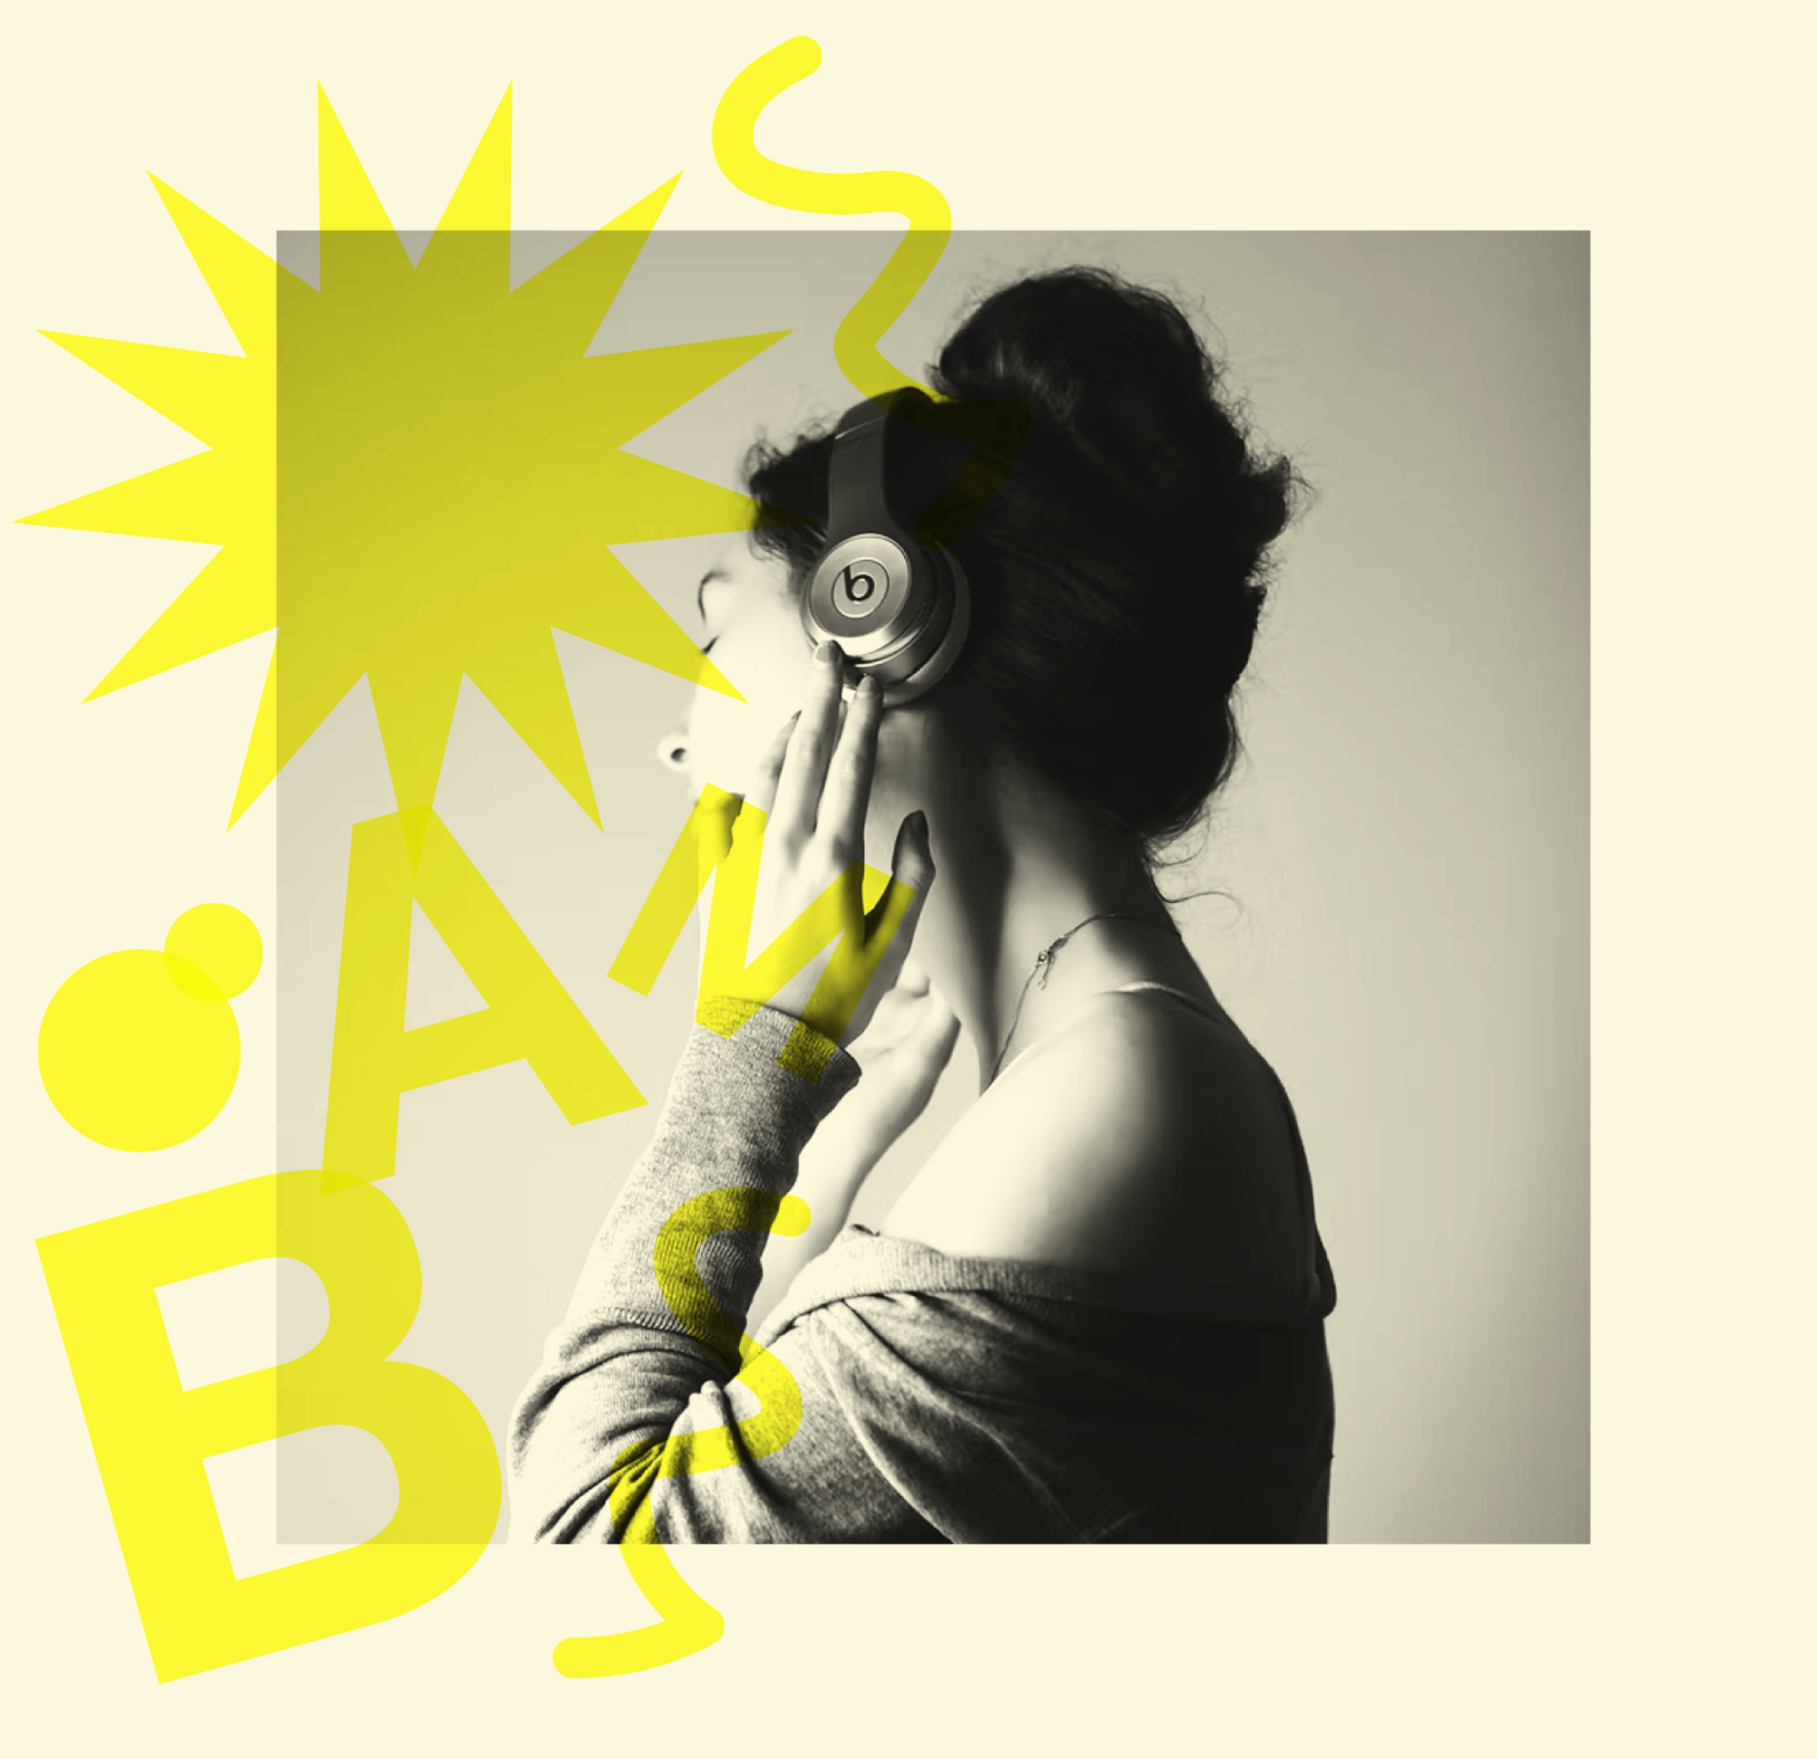
SOLUTION
Audio interpretation (provided by hearing people – can be in the form of text, drawing, etc) of different media that have audio…
Can be how it makes you feel, details that are important to the overall meaning, or straight up captions.
Upvote system to maintain accountability and provide useful/interesting interpretations

Slide 20
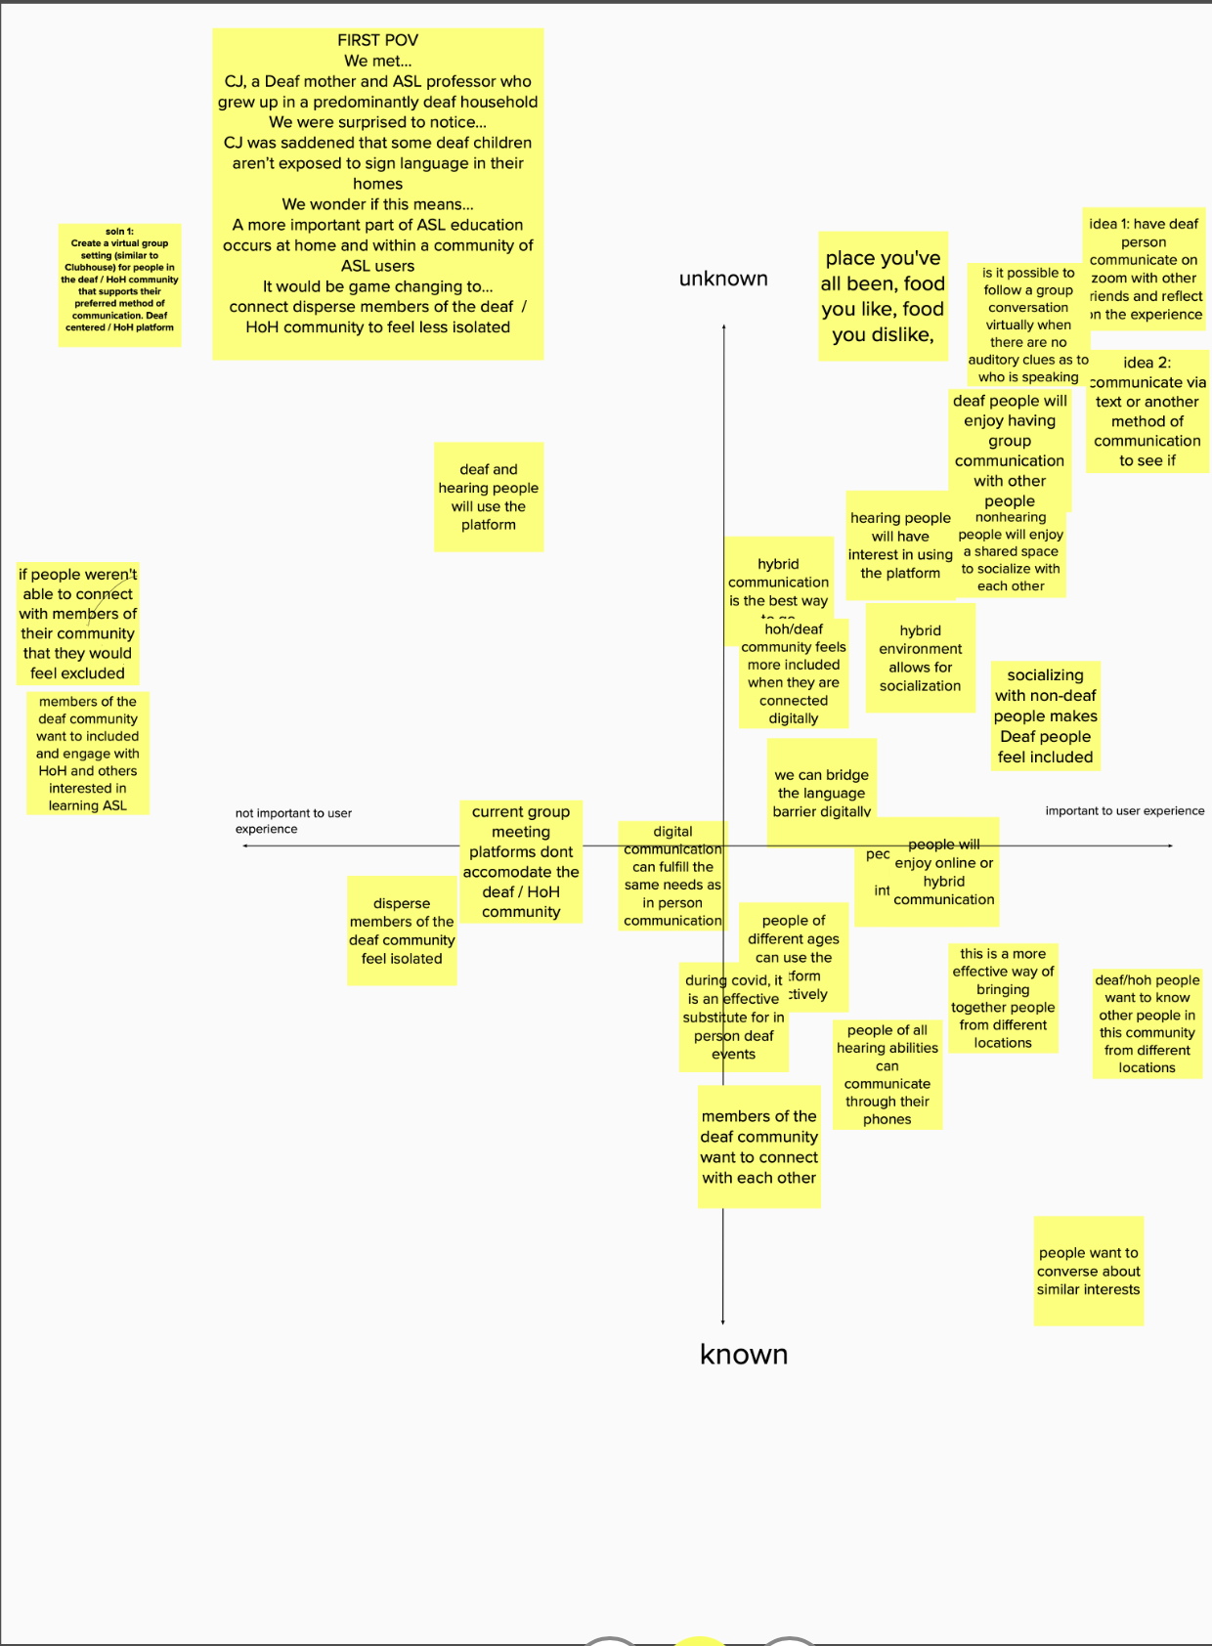
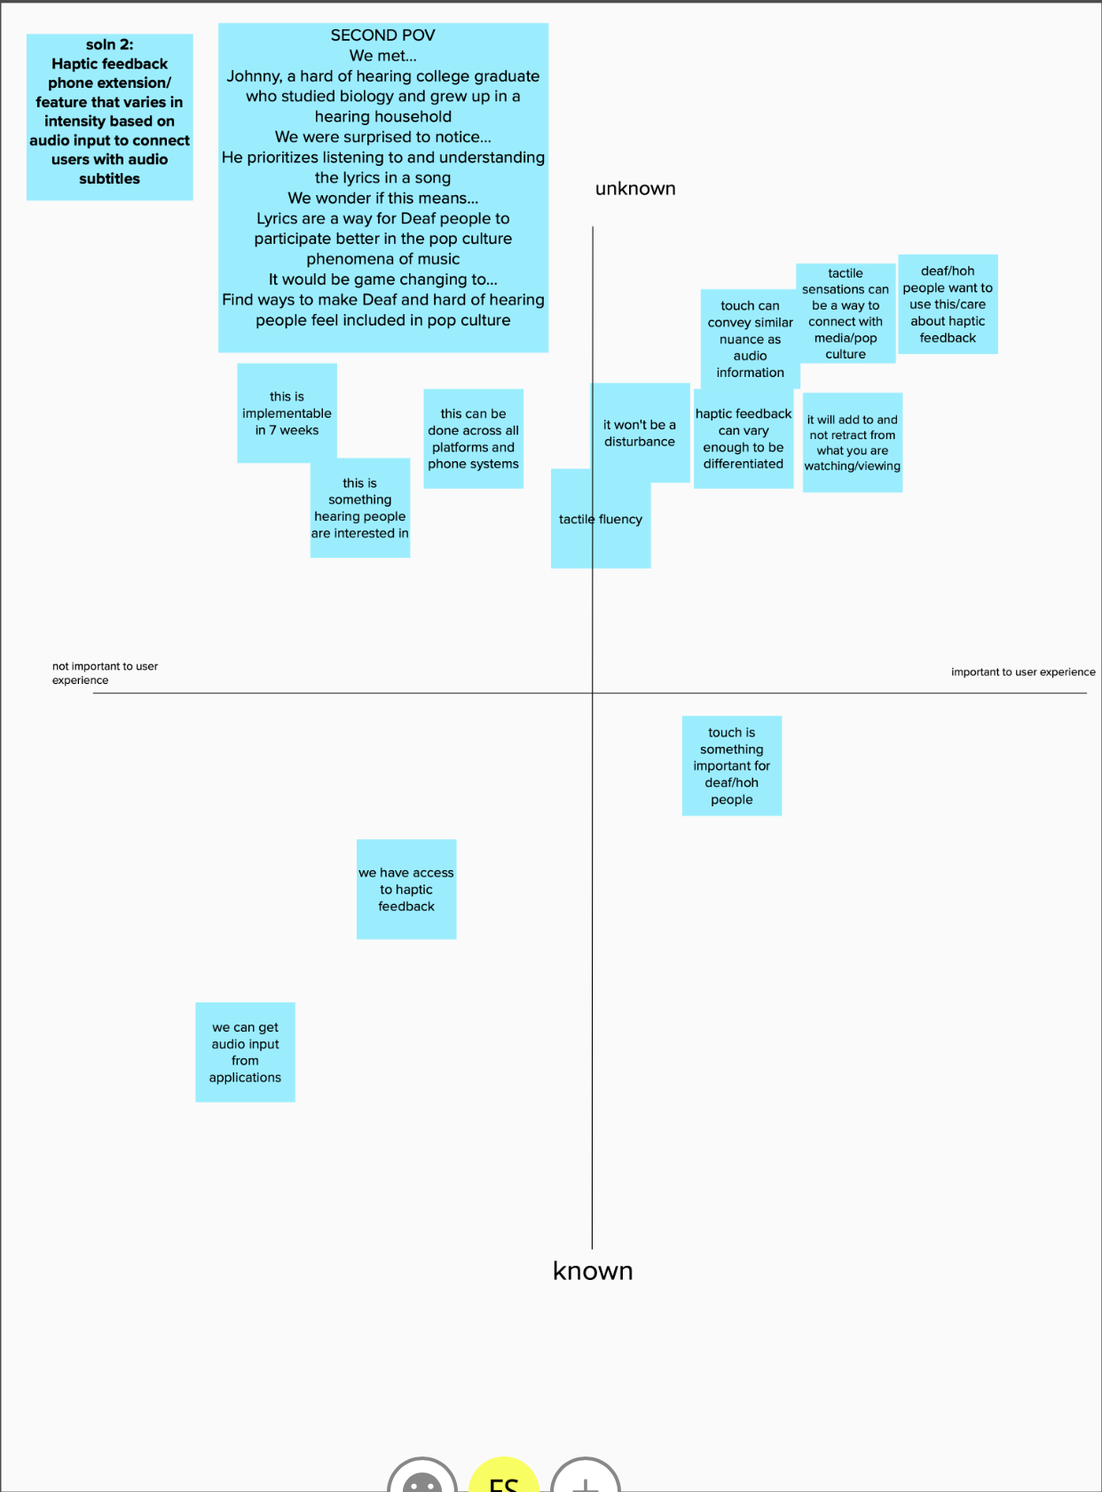
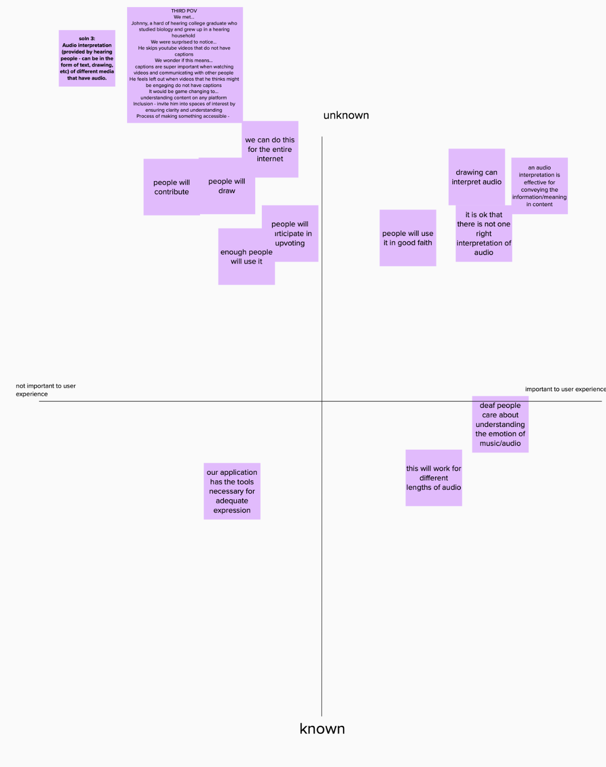
ASSUMPTIONS

Slide 21
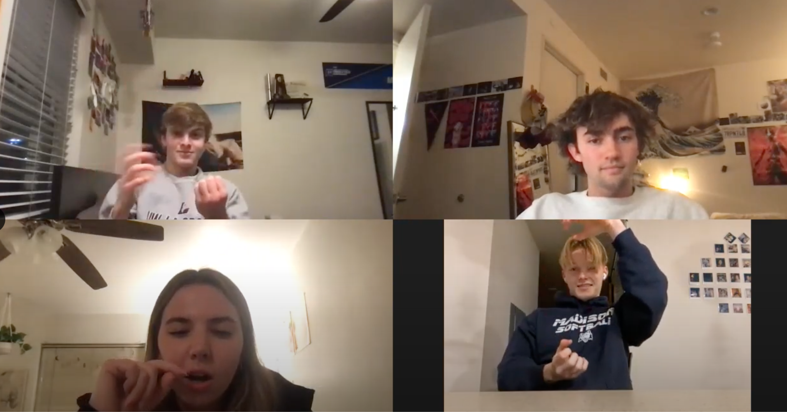
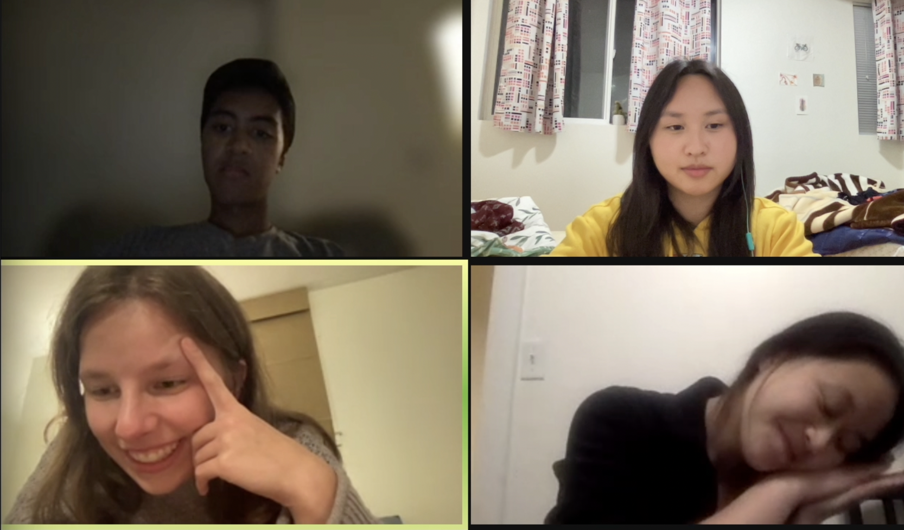
EXPERIENCE PROTOTYPE 1
DESCRIPTION
Minimum of three people in a zoom call. All members have their audio off and need to figure out the question “what food do you all dislike”. Only visual cues are allowed, no text or words.
Communication can be effective and smooth with video only in a small group setting.
ASSUMPTION

Slide 22
EXPERIENCE PROTOTYPE 1 RESULTS
We interviewed two groups of three people. Both were hearing and due to scheduling conflicts we were not able to interview a third group of ASL speakers.
Things that worked
Things that didn’t work
Group decided: “beef tongue”
Communicating visually
When someone “took the lead”
Awkward silence in the beginning
Some people dominated the conversation
“Hard to convey abstract concepts”
People were different sizes on the screen
Blurred background made gestures difficult to see
Surprises
New learnings
“Easier time focusing”
No one could “talk over” anyone
They didn’t expect to find a common ground and they did
A visual group conversation can occur on a virtual platform
In this space there is often only one speaker at a time; helps people stay present
We need to explore ASL use in digital space

Slide 23
EXPERIENCE PROTOTYPE 1 VALIDITY
PARTIALLY VALID
It became clear that visual communication can be effective in a virtual space due to the success of the groups, however this communication style appears to be less fluid and dynamic (more like speaker-audience) than in-person conversation–at least for hearing people

Slide 24
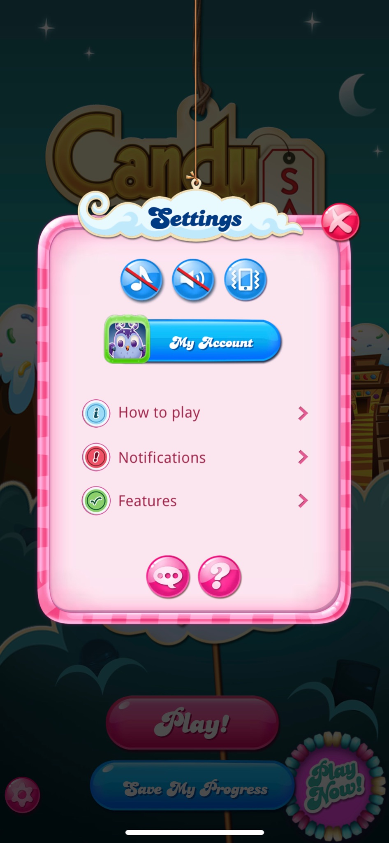
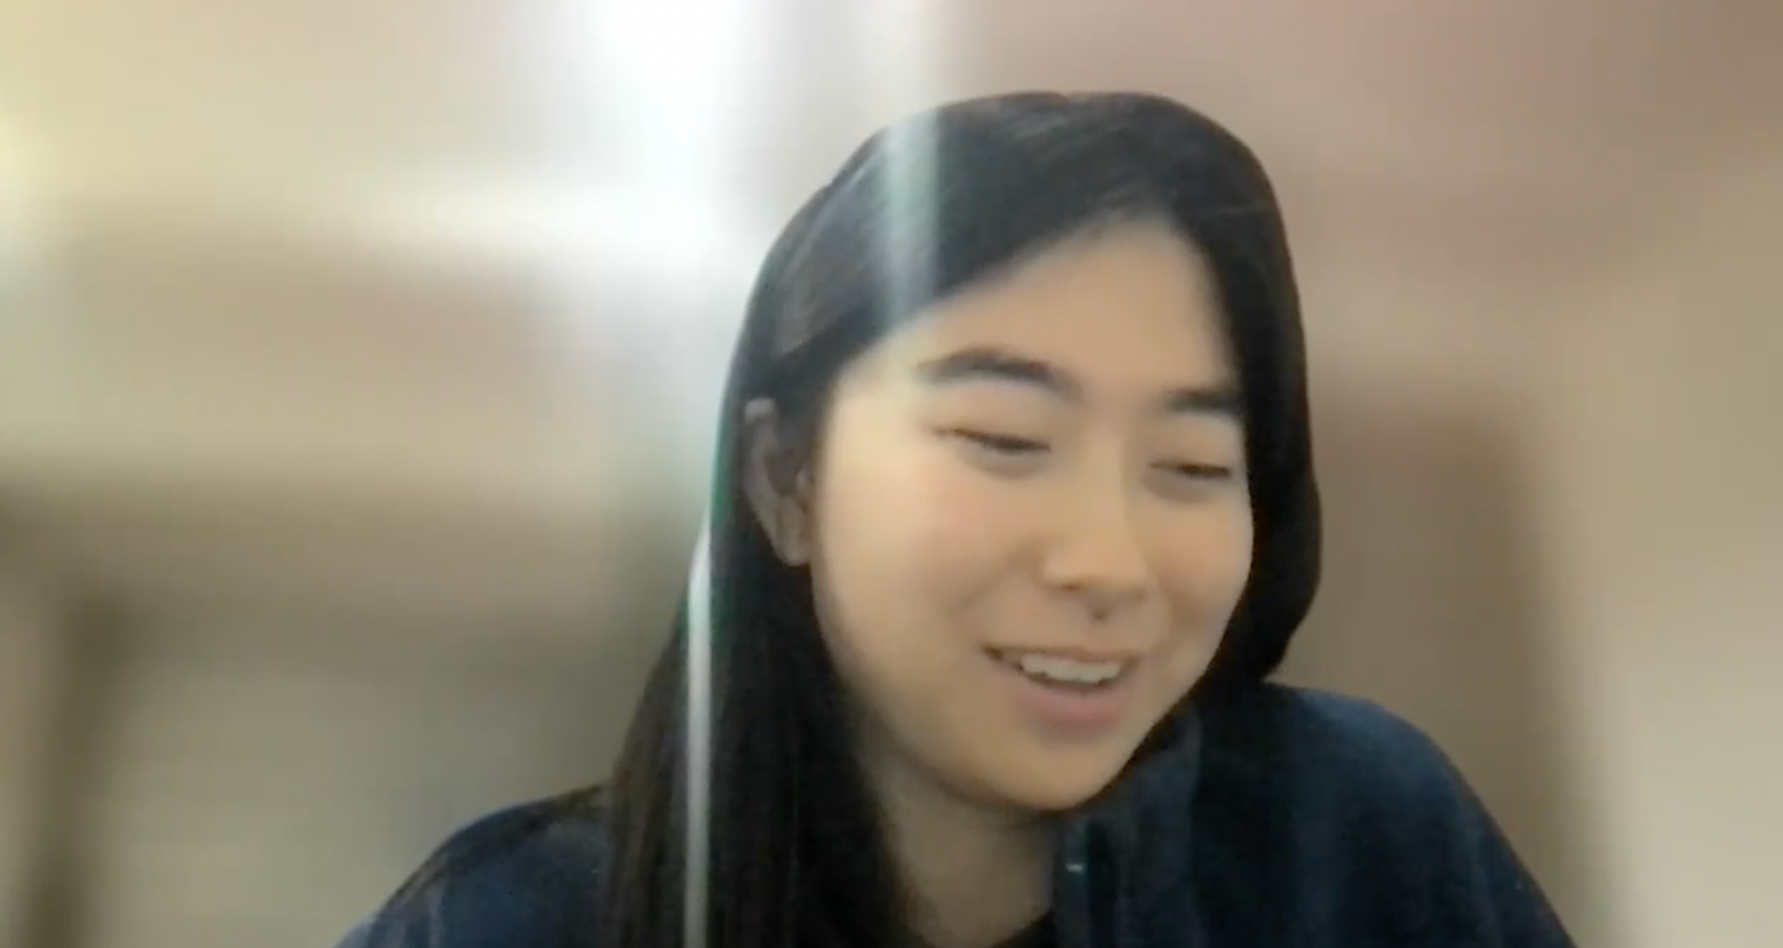
EXPERIENCE PROTOTYPE 2
DESCRIPTION
We have a user play Candy Crush on the iPhone for 3 minutes with haptic feedback. After the 3 minutes are up, we have them turn off the haptic feedback in settings.
ASSUMPTION
Haptic feedback will add to and not retract from what you are watching or viewing.

Slide 25
EXPERIENCE PROTOTYPE 2 RESULTS
We interviewed 2 people. Due to technical difficulties, we weren’t able to test directly with one of them who was hard of hearing (participant A). The other participant was hearing (participant B).
Things that worked
Things that didn’t work
Participant B preferred the haptic feedback to the visuals of the game
Haptic feedback can be useful in urgent situations (participant A).
Haptic feedback makes me anxious and distracted (participant A)
Participant A feels haptic feedback is distracting
Participant B felt the game visuals were distracting and too flashy
Surprises
New learnings
Vibration is completely turned off by participant A
Haptic feedback can be useful when learning.
Haptic feedback was felt before visual feedback.
We need to get more feedback from deaf and hard of hearing people.
Preference to having haptic feedback is context dependent.

Slide 26
EXPERIENCE PROTOTYPE 2 VALIDITY
INCONCLUSIVE
The participant who was hard of hearing didn’t experience haptic feedback positively, while the hearing participant did. We would need to test with more hard of hearing and deaf people to get their input.

Slide 27
EXPERIENCE PROTOTYPE 3
DESCRIPTION
Two interviewees take turns between: interviewee A listening to a song and drawing how it ‘feels,’and interviewee B interpreting said drawing. After the exercise, both interviewees listen to the audio together and compare their experience and expectations.
We chose songs that ranged between instrumentals, non-English, and English and observed the difference in drawings.
ASSUMPTION
A unique audio interpretation can be effective for conveying the nuance in information/meaning in content

Slide 28
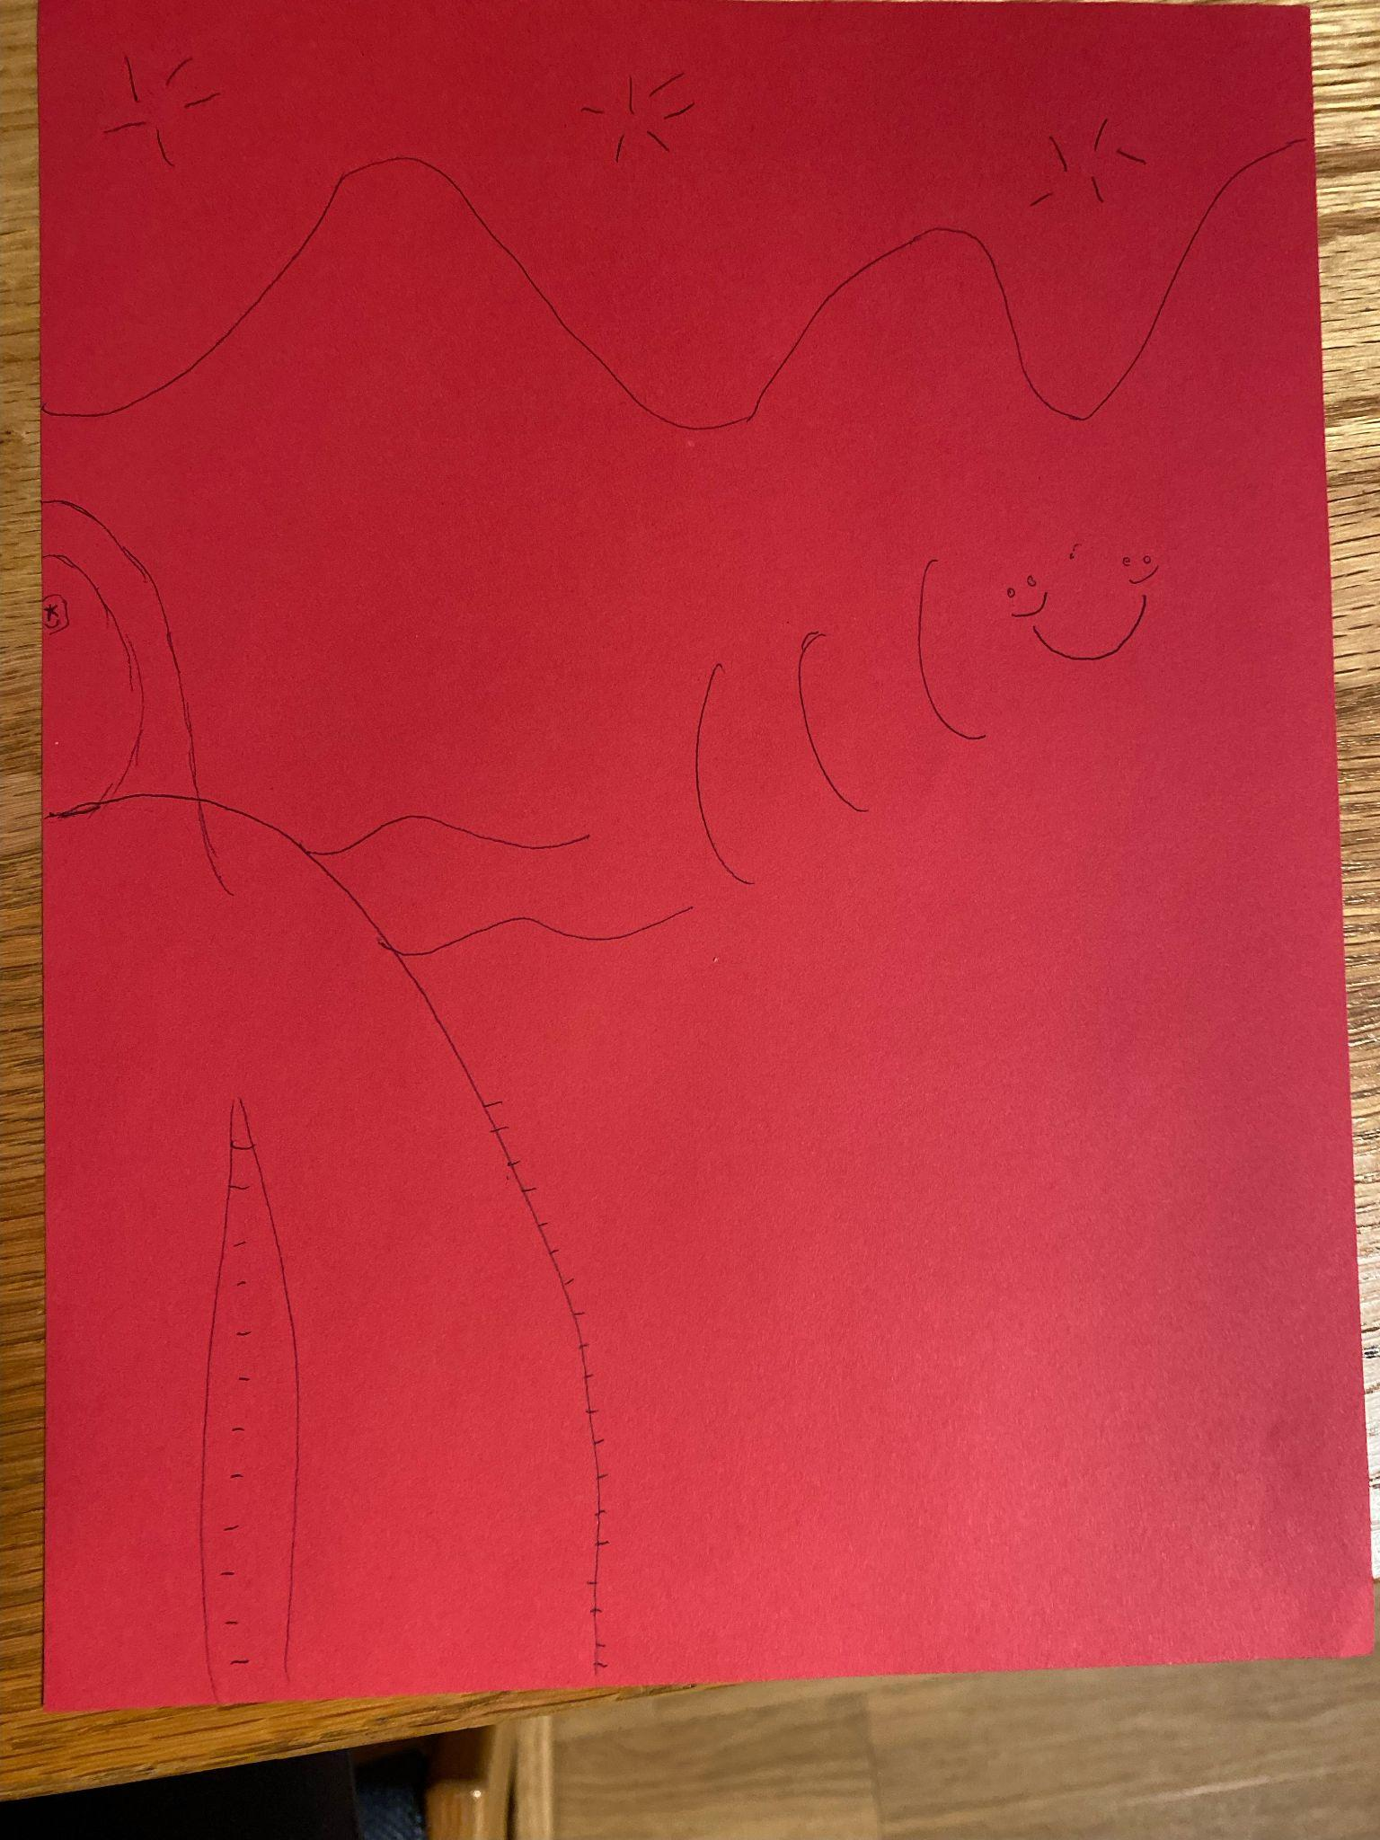
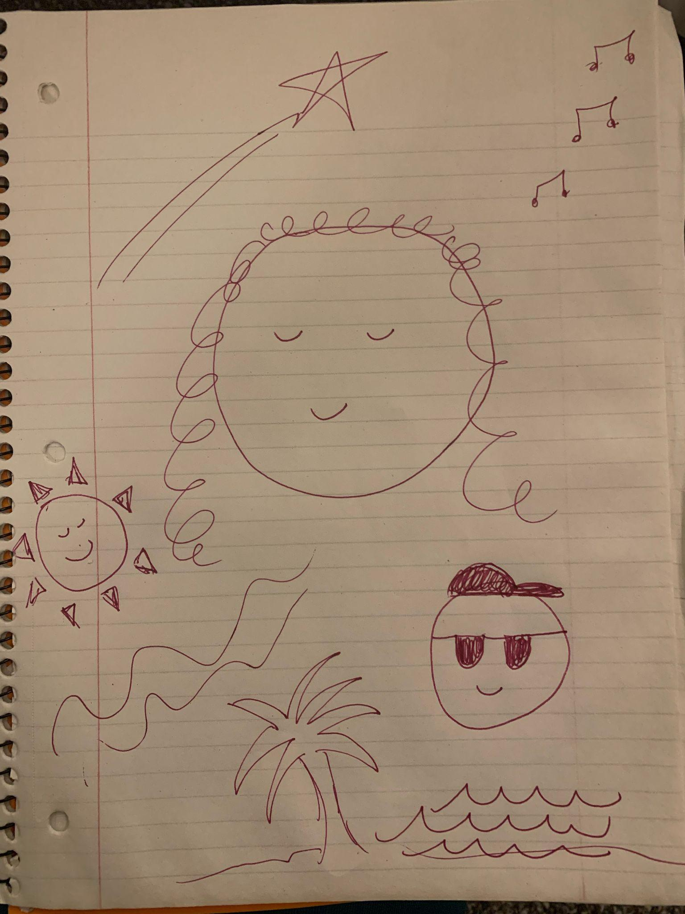
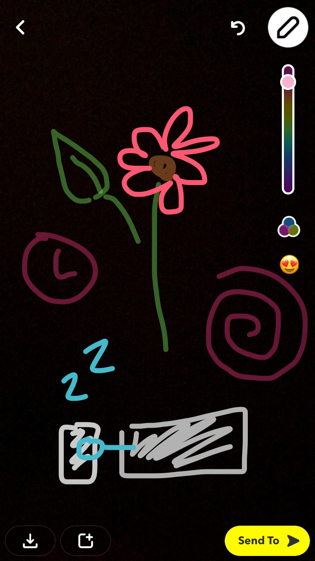
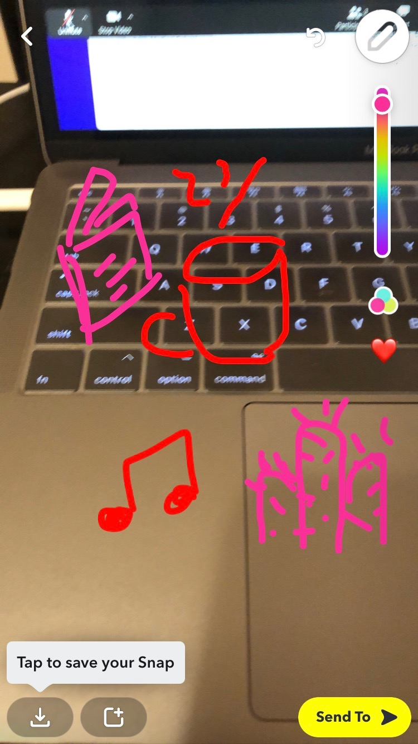
EXPERIENCE PROTOTYPE 3 RESULTS
Instagram - DEAN
Corpus Christi - PRETTYMUCH
Instagram - DEAN
Andy Brown Trio at the Whiskey Lounge

Slide 29
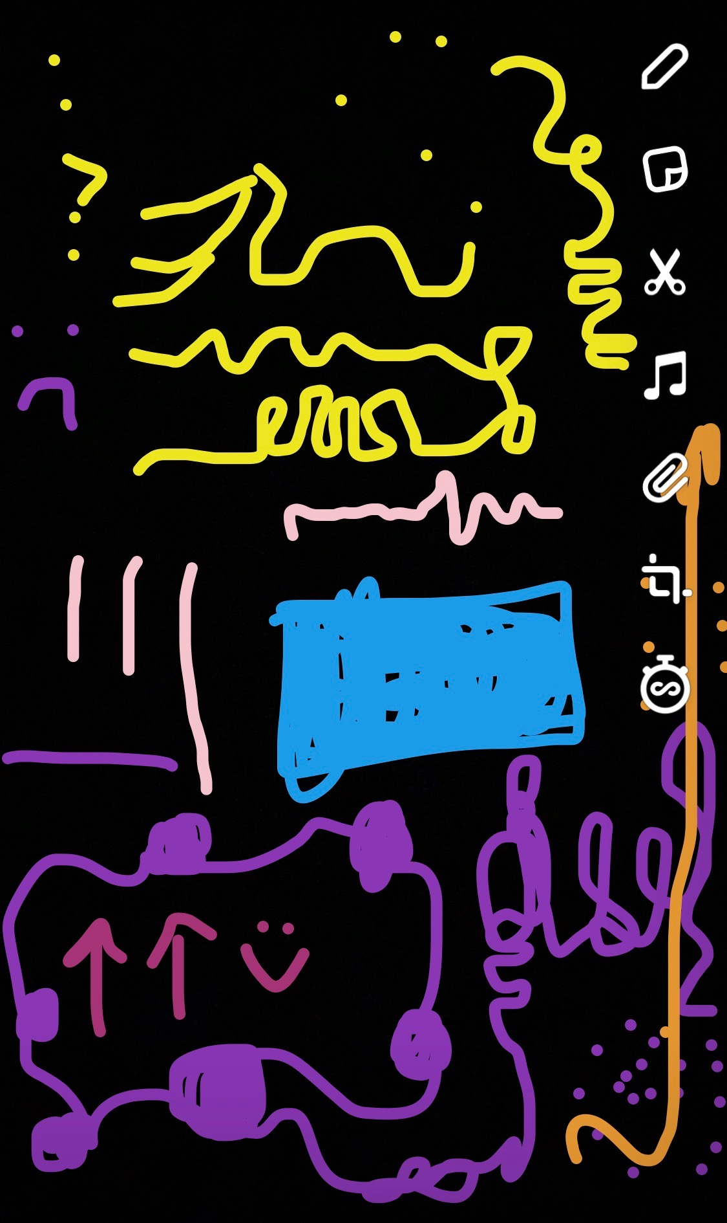
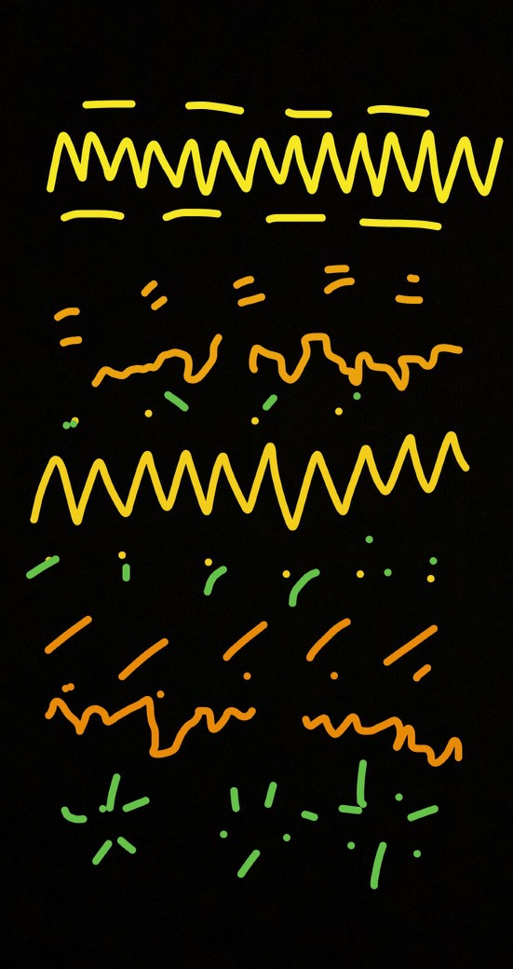
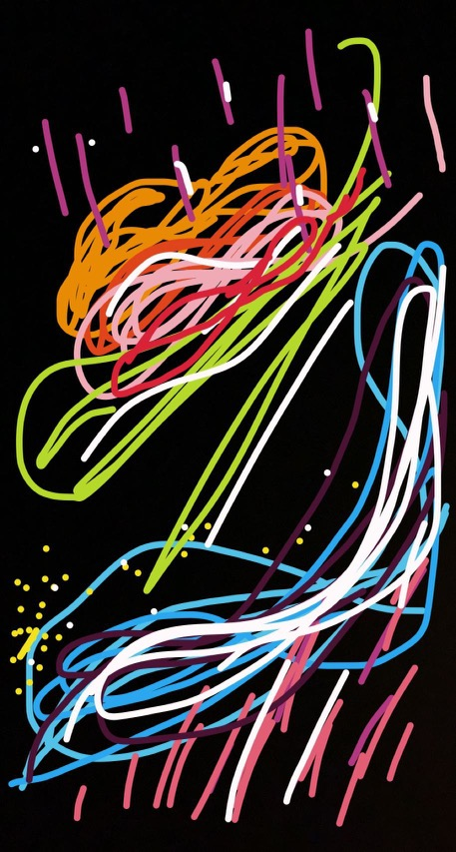
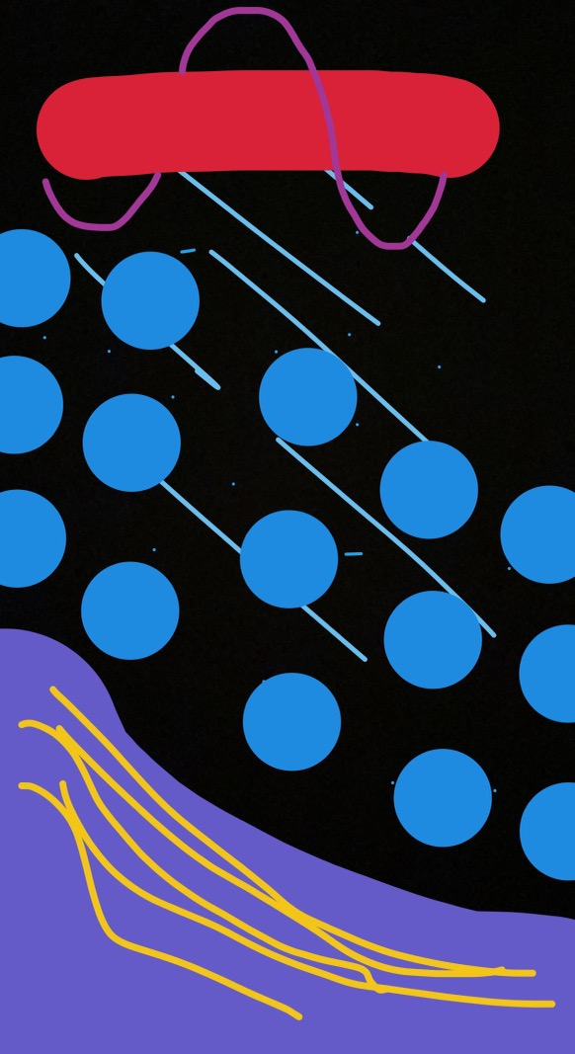
EXPERIENCE PROTOTYPE 3 RESULTS
Instagram - DEAN
Andy Brown Trio at the Whiskey Lounge
Instagram - DEAN
idontwannabeyouanymore - Billie Eilish

Slide 30
EXPERIENCE PROTOTYPE 3 RESULTS
We interviewed four groups of varying amounts of people. All participants were hearing.
Things that worked
Things that didn’t work
Interviewees enjoyed the activity
Interviewees relayed their feelings through drawing
Interviewees could accurately extrapolate some kind of feeling from the drawings
Interpretation without info. was daunting
Doing the exercises sequentially could potentially influence the second drawer
Surprises
New learnings
non-English songs had an effect on the approach to drawing
abstract vs. symbolic
The constraint of using Snapchat was enjoyable
Guidance and encouragement would help reduce doubt
People are excited about using this prototype
Drawing in real time might be interesting to explore

Slide 31
EXPERIENCE PROTOTYPE 3 VALIDITY
VALID
To a certain extent, each participant was able to infer some kind of meaning from each drawing, despite the diverse and unique approaches each interviewee had to translating the audio.
“She got more out of it than I even realized was there” - Participant 015

Slide 32
MOVING FORWARD
We want to continue investigating solution three
Focus on alt. visuals
Center Deaf/HoH community
IN GENERAL
Potentially look into centering ASL and/or captions as part of
alt. visuals
Continued investigation of haptic feedback with Deaf / HoH individuals (integrate with visuals)
Investigate ways to support alt. visual creators with prompts or suggestions

Slide 33
SUMMARY
Most of our problems and investigations centered around creating shared experiences within the Deaf / HoH community and with the hearing community
Accessible design is better refined when more opinions from all communities are collected and compared
Continue searching for more participants in the Deaf community and centering Deaf perspectives in our design

